Slide 1
Business Continuity and Resiliency

Slide 2
Business Continuity and Resiliency
Business Continuity represents the ability to perform essential business functions during and after adverse conditions
Ensure your internal and external applications are remaining operational during planned downtime and unplanned outages.
Focus on failure recovery, rather than on avoiding failure

Slide 3
High Availability
High Availability is the ability of the application to continue running in a healthy state despite localized or transient failures.

Slide 4
Disaster Recovery
Disaster Recovery is the ability to recover from major incidents such as service disruption that affect an entire region.
Ex: Order processing application

Slide 5
Virtual Machine High Availability
Availability Set – Single Point of Failure
Availability Zone – Datacenter level Failure
Virtual Machine Scale Set - Autoscaling
Replication of VM
Multi-Region

Slide 6
Storage Replication
LRS
ZRS
GRS
RA-GRS
GZRS
RA-GZRS

Slide 7
Data Backup
Backup is distinct from data replication
Data replication is copying data in near real time
Point in time restore needs a data backup
Storage – Snapshots, Backup
VM – Backup in recovery services vault
App Services – Storage Account
SQL Databases – Backup in recovery services vault

Slide 8
Identifying Requirements
Recovery Time Objective (RTO) Maximum acceptable time that an application can be unavailable after an incident.
Recovery Point Objective (RPO) Maximum duration of data loss that is acceptable during a disaster.
Mean Time to Recover (MTTR) Average time it takes to restore the application after a failure

Slide 9
Service Level Agreement
Uptime and connectivity maintain
Obtain service credits incase SLAs are not met

Slide 10
Estimating SLA Downtime
Ex: Web App writes the data to Azure SQL Database
Azure App Service = 99.95%
SQL Database = 99.99%
Composite SLA = 99.95% x 99.99% = 99.94%
SQL Database is unavailable, Add queue – transactions can get stored in the queue
Service Bus Queue = 99.9%
Web App AND (Database OR Queue) ~ 99.95%

Slide 11
Application Design

Slide 12
Failure Mode Analysis (FMA)
Process for building resiliency into an application early in the design stage.
Identify what types of failures an application might experience
Capture the potential effects and impact of each type of failures
Identify the recovery strategies

Slide 13
Ecommerce Application
Database
Product Listing
Product Searching
Shopping Cart
Payment Gateway
Invoicing
Order Transferring
Order Processing
Shipping & Tracking
Delivery
Service Support
Order History
Login
Product Reviews
Marketing and Promotions
Cancellation and Refunds
Subscriptions

Slide 14
Ecommerce Application
Payment Outage / Payment Gateway
Order Placement
Load on Server / Latency / Performance
Website Unavailable – 403 / Login
Security / Hacked
Order Tracking Failure

Slide 15
Ecommerce Application
Application not reachable – 404, 5xx – HA, Scalability
Slow response from some pages – throttling – 429 – too many rquest – scalability, DDoS, WAF
Authentication – HTTP 401 (unauthorized), HTTPS, SSL Certificates
Website not being browser compatible – Application Design, Responsive
Component Failure – Individual FMA for component
Integration Service – DB, Messaging, LB
DDOS – Basic, Application level attacks you should take.

Slide 16
Ecommerce Application
Database Failed
Application server running slow – 503
Payment Outage
Page not found
Downtime
Sessions not maintained
Inventory

Slide 17
Ecommerce Application
Application not reachable – 404, 5xx – HA, scalability
Slow response from some pages – throttling – 428 – too many request – scalable, DDoS
Authentication – HTTP 401 (unauthorized), HTTPS, SSL Certificate
Website not being browser compatible – Application Design, Responsive
Component Failure – Individually FMA for components
Integration Service – DB, Messaging, LB
DDoS – Basic, Application level attacks you should take care.

Slide 18







Avoiding a Single Point of Failure
Single VM - SLA with Premium Disk - 99.90%
Availability Sets – Fault Domains and Update Domains – 1 Single DC Ex: 2 Web Server and 2 Database Servers
Availability Zones
Azure Site Recovery
Paired Regions

Slide 19






















Azure Autoscaling and Load Balancing
Placing two or more VMs behind a load balancer
Scaling out an Azure App Service app to multiple instances
Using Azure Traffic Manager
VMSS

Slide 20


























Slide 21


























Slide 22












Slide 23
Traffic Manager
Priority
Performance
Geographic
Weighted

Slide 24
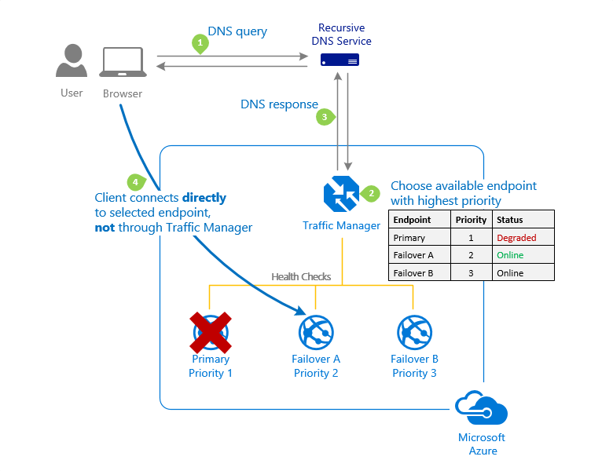



Slide 25
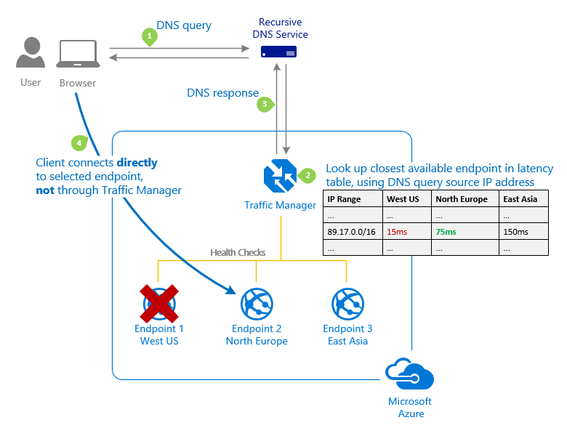

Slide 26
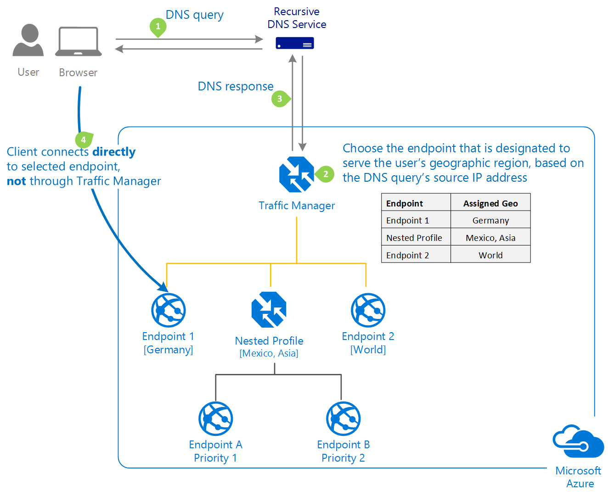

Slide 27
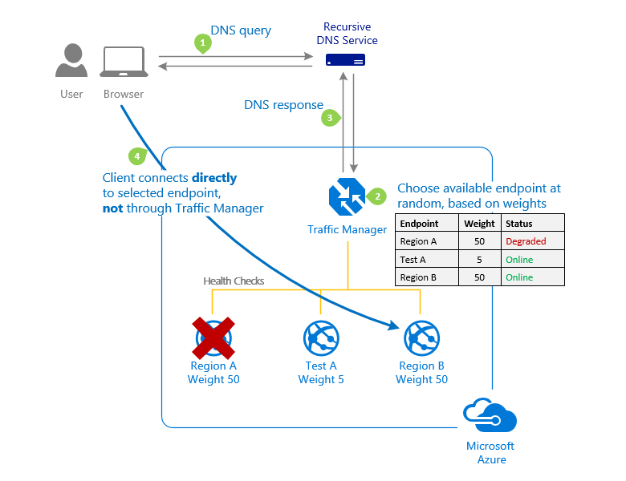






















Slide 28
3 Web Apps in 3 Different Region
App Service Plan – S1

Slide 29
You need to deploy a web application and ensure below criteria is met
You should be able to scale upto 15 instances of application
You should be able to take 15 backup of application daily
You should be able to have auto scaling support for application
Which app service plan should you choose
Basic – Upto 3 instances
Standard – 10 instances, 10 times daily backup
Ultimate – Easy Elimination
Premium – 20 instances, 50 times daily backup
Free – Easy Elimination

Slide 30
Workload Service level Objectives
Configure workloads by service level objectives
Critical and less-critical workloads

Slide 31
E-Commerce
Payments - Critical
Search – Huge Load - Critical
Cart and Checkout - Critical
Inventory – Non-critical
Login - Critical
Database - Critical

Slide 32
Video Streaming Application (Netflix, Hotstar, Amazon Prime)
Live Streaming Engine - Critical
Storage - Critical
Video Compression – Non-critical
UI – Non-critical
Login - Critical
Profiles – Non-critical
Search - Critical
Commenting Capability – Non-critical
Monetization – Non-critical
Last Played Status – Non-critical
Database - Critical
Payment - Critical
Inventory – Non-critical
Video Player - Critical

Slide 33
Video Streaming
User Interface (UI): Non-Critical Listing Management: Critical Search and Discovery: Critical Booking and Reservation System: Critical Messaging and Communication: Critical Review and Rating System: Less Critical Payment Gateway Integration: Critical Host Dashboard: Non-critical Admin Panel: Critical Trust and Safety Measures: Non-Critical Localization and Multi-language Support: Non-Critical Mobile Apps: Critical

Slide 34
Enhancing Security
DDoS – Network Layer
DDoS – Application Layer – Captcha, Image Recognition
SSL Certificate – HTTPS
Principal of least Privilege – RBAC
MFA – Authorization and Authentication
NSG

Slide 35
Hacking
Phishing – Ensure you watch URL properly – Fake mail – facebook.xyz.com
Key Logging
Simple Passwords – Mobile Number, Yourname@birthyear, Yourspousename@birthyear – Brute Force Attack
Security Questions – Right answers to the security question
Ethical Hacking - Learning

Slide 36








Gracefully Degrade Application

Slide 37
Throttle high-volume users

Slide 38
Maximize Application Availability
Release Process
Blue/Green – Deployment Slots
Canary Release – Weighted Routing, roll out a feature to small set of users

Slide 39
Monitoring and Alerting
Monitoring and Alerts – Azure Monitor and Alerts
Alerts – Activity Log or Metrics
Log – Diagnostic, Telemetry, application logs

Slide 40
Test the Monitoring Systems
Drill Operation
Plan for testing disaster recovery

